Slide 1


Credit Risk Analysis
Suraaj Hasija

Slide 2



Problem statement
Two types of risks are associated with the bank’s decision:
If the applicant is likely to repay the loan, then not approving the loan results in a loss of business to the company
If the applicant is not likely to repay the loan, i.e. he/she is likely to default, then approving the loan may lead to a financial loss for the company.
Hence, the company wants to understand the driving factors (or driver variables) behind loan default, i.e. the variables which are strong indicators of default.

Slide 3
Analysis for missing values
We found that were are around 40 columns with more than 50% missing values. Since most of the data is not available in these columns its better not to consider them for analysis.

Slide 4










AMT_ANNUITY: Since we have very low count of missing values in this column, we can impute them by mean.
NAME_TYPE_SUIT: We can impute the missing values in this column by mode i.e., Unaccompanied
Imputation for missing values less than 13%
OCCUPATION_TYPE: We can impute the missing values in this column by a new category i.e., Others
CNT_FAM_MEMBERS: We can impute the missing values in this column by 0 since this column has very low count of missing values and 0 looks more natural.
AMT_GOODS_PRICE: We can impute the
missing values in this column by median.

Slide 5
Data Types of the columns
We notice that the columns have been stored in 64-bit which occupies a lot of space unnecessarily and is not needed.
Hence we change the data types of all the columns from ‘float/int 64’ to ‘float/int 64’.

Slide 6







Analysis of numerical
columns for outliers

Slide 7

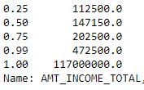

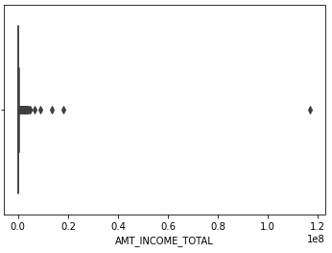

AMT_INCOME_TOTAL
From the boxplot and the difference between 0.99 &1.0 Inter-quartile range we can clearly notice that there are outliers in this column.
Hence, we decide to remove the outliers i.e., the values greater than 0.99 IQR from the column.

Slide 8
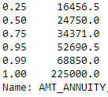
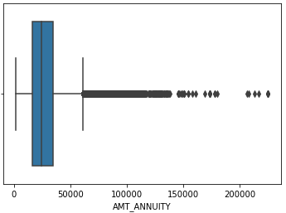
AMT_ANNUITY
From the boxplot and the difference between 0.99 &1.0 Inter-quartile range we can clearly notice that there are outliers in this column.
Hence, we decide to remove the outliers i.e., the values greater than 0.99 IQR from the column.

Slide 9
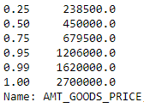
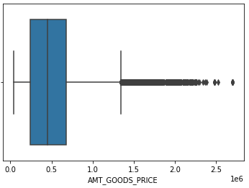
AMT_GOODS_PRICE
From the boxplot and the difference between 0.99 &1.0 Inter-quartile range we can clearly notice that there are outliers in this column.
Hence, we decide to remove the outliers i.e., the values greater than 0.99 IQR from the column.

Slide 10

Binning of Continuous Variables
We decide to bin the AMT_INCOME_TOTAL column into 3 bins, namely:
Low Income: with values less than the 0.3 IQR value of column
Average Income: with values between 0.3 and
0.7 IQR values of column
High Income: with values more than the 0..7 IQR value of column

Slide 11
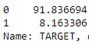
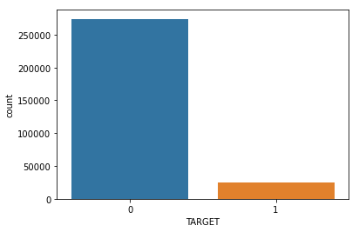
Data Imbalance
From the above count plot and the value counts of the TARGET column, we can clearly state that there is data imbalance.
Number of defaulters are less than one-tenth of the number of non- defaulters.

Slide 12




Univariate Analysis

Slide 13
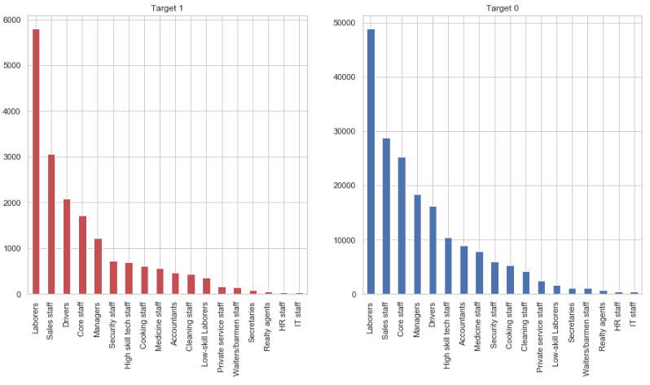
OCCUPATION_TYPE: We can see that most of the loans are taken by Loborers followed by Sales Staff, Core Staff etc. and the defaulters to non defaulters also follow the same sequence.

Slide 14
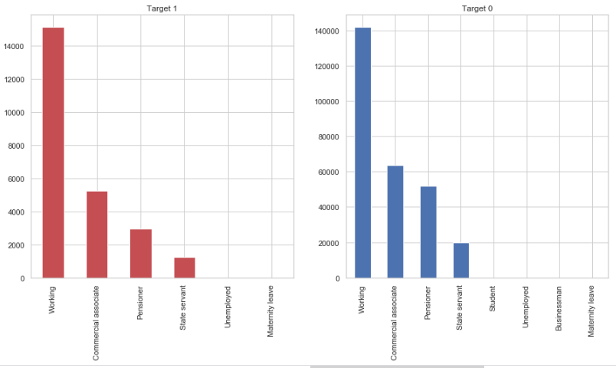
NAME_INCOME_TYPE: We see that working professionals
take most of the loans, more than triple of any category.

Slide 15
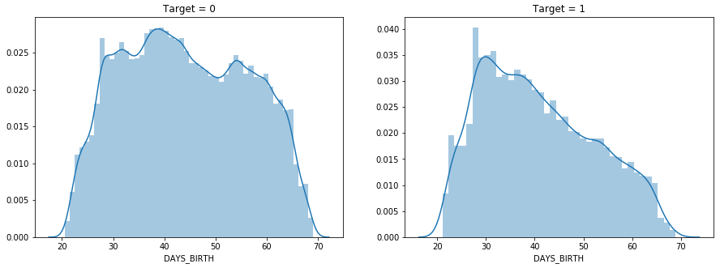
DAYS_BIRTH(in years): We notice that the age of clients in the case of non-defaulters are normally distributed whereas they are left skewed in the case of defaulters.

Slide 16
Bivariate Analysis

Slide 17
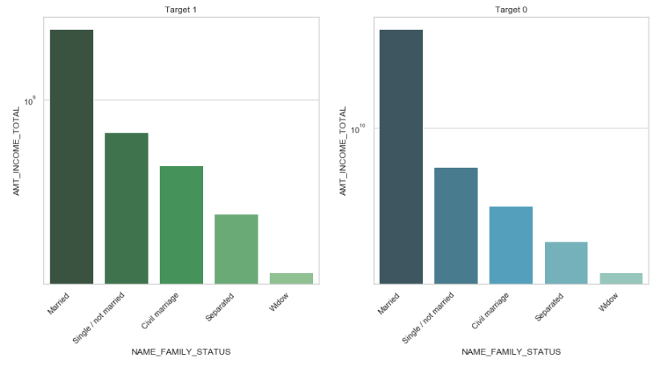
AMT_INCOME_TOTAL – NAME_FAMILY_STATUS: We
can see that most of the loans are taken by Married customers
whereas widowers do not take much loans.

Slide 18
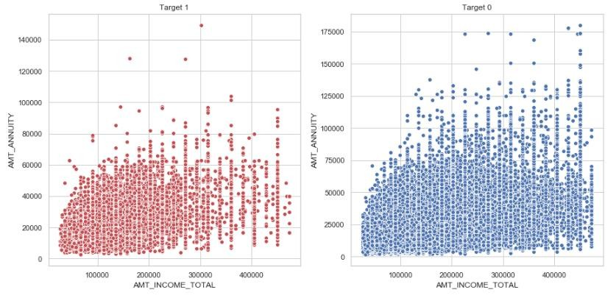
AMT_ANNUITY – AMT_INCOME_TOTAL: We notice
that the amount paid by the client to the bank is uniformly
distributed across the range of their income.

Slide 19
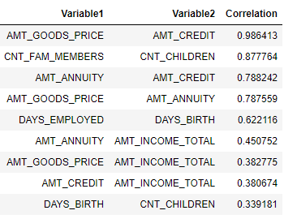
After comparing the two data sets for Target = 1 and Target = 0, we find that the sets of correlated columns are same for both the datasets.
AMT_GOODS_PRICE is highly correlated to AMT_CREDIT in both the datasets. Similarly CNT_FAM_MEMBERS is highly correlated to CNT_CHILDREN and so on.

Slide 20
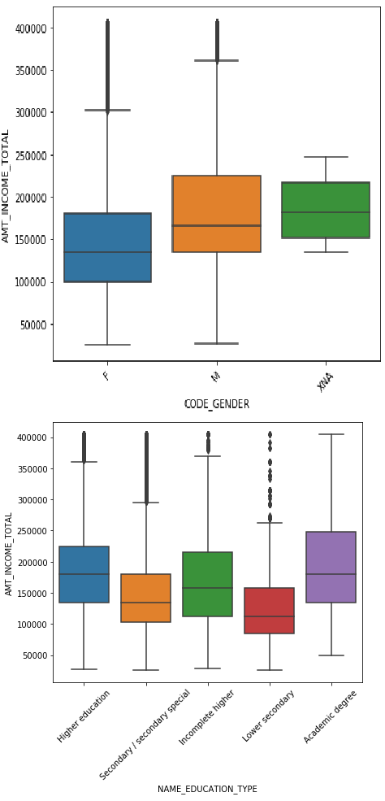
AMT_INCOME_TOT
AL and other Categorical variables
We notice the following from various plots:
Females have comparitively lower income than Males and Others.
People with comparitively higher income
own the cars.
There is no significant of income on owning a house or a flat.
Clients with Higher education and Academic degree have comparitively higher income than others.
There is no significant of income on Family Status.

Slide 21
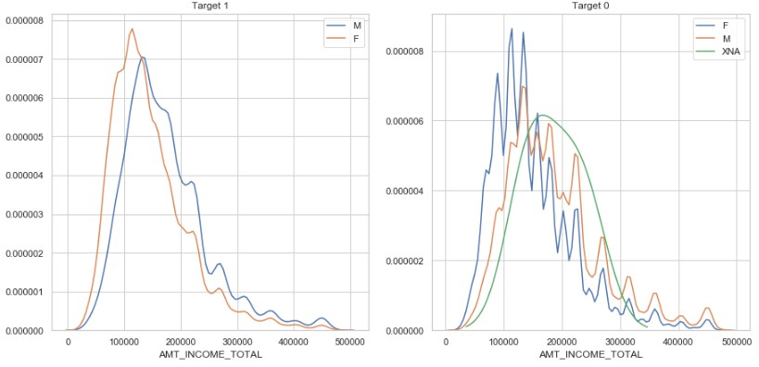
AMT_INCOME_TOTAL - CODE_GENDER: We notice that the clients with income between 50000 & 250000 take most of the loans and most of the defaulters are also from the same range across all genders.

Slide 22
Previous Application Data Processing
Now we do the analysis for the Target variable based on the information given to us in the previous application data

Slide 23
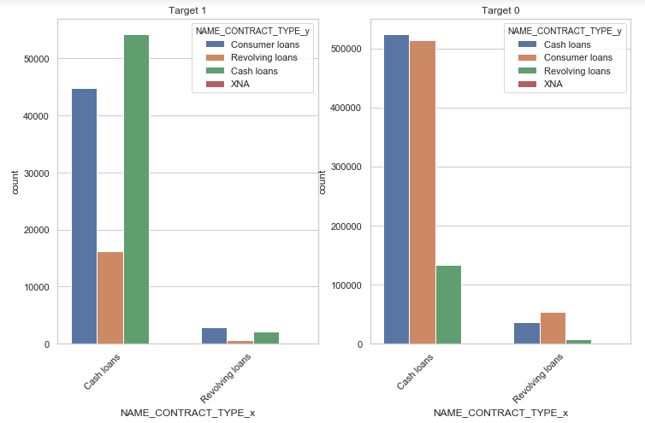
Shift in contract type from previous to current application. The two categories – Consumer loans and XNA have been shifted to Cash and Revolving loans

Slide 24
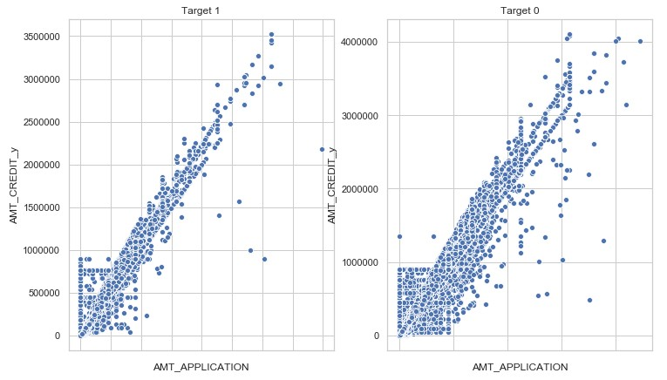
Checking the variation between credit amount and the amount
for which the client initially applied in the previous application.
The graph is more scattered in case of non defaulters.

Slide 25
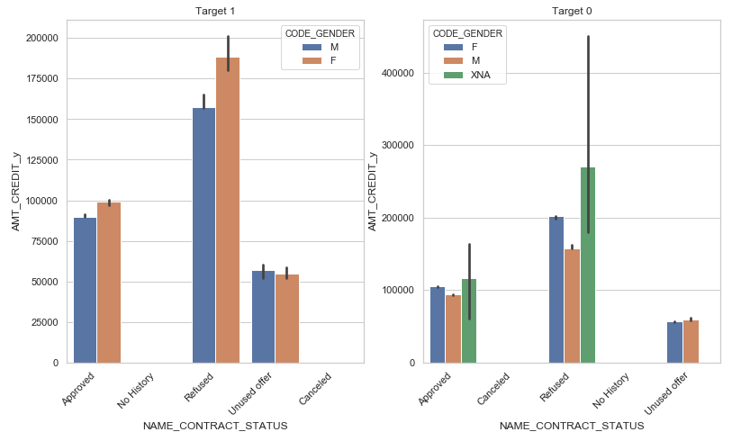
Previous application contract status and median credit amount
by gender.

Slide 26
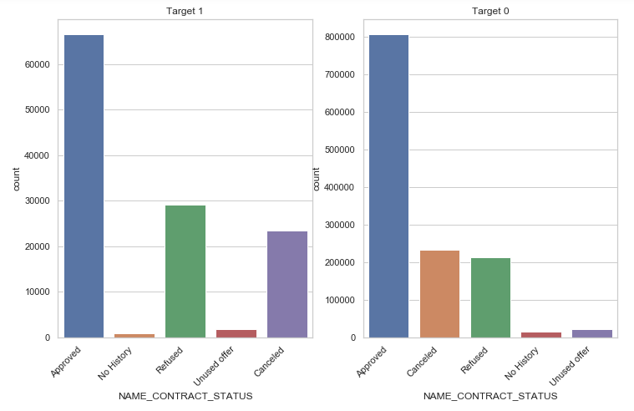
Customers in current application with previous application contract/loan status. Loan seems to be approved for majority of the defaulters which seem to have caused a loss to the company. But also majority of the non-defaulters have their loans sanctioned.

Slide 27
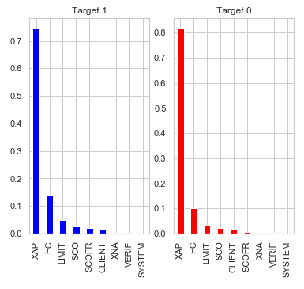
Checking the cause of rejection in previous applications. And it
has been same in both the cases.

